Slide 1

The Movie Recommender Explore cinema your way!

Slide 2
Motivation
Watching movies is one of my favorite pass times.
But I don’t always like the movies I watch and I don’t want to spend close to 2 hours figuring that out.
The Movie Recommender can help suggest movies, which people with similar tastes like. So you can find some new favorite flicks without wasting time.

Slide 3
Demo

Slide 4
Data
Movie Lens Dataset
Used smaller version with 100,000 ratings from 600 users on 9000 movies.
Smaller dataset performed faster but not as accurate.

Slide 5
Model and Success
Used SVD – Singular Value Decomposition
Initially planned to use AUC (Area Under Curve) to score results, but was difficult to implement.
Instead, RMSE was used on ratings. SVD performed better than KNN.

Slide 6
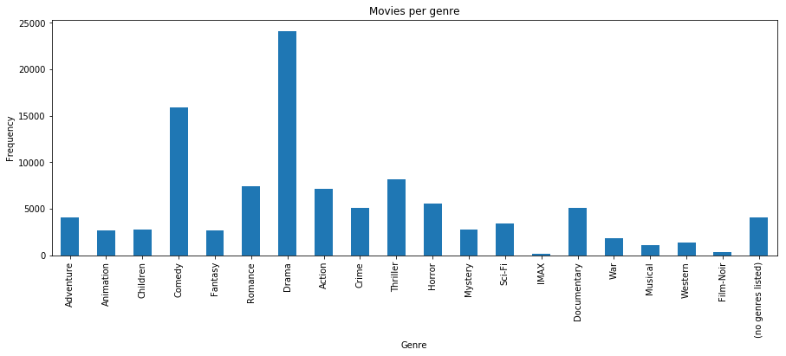
Interesting Insight
Hollywood seems to like to produce Drama and Comedy films.
That is most likely what people like to see in movies.

Slide 7
Improvements Needed
Better User input interface.
Genre filter to help narrow down choices.
Use bigger dataset.

Slide 8
Thank you!
Bio/Contact Info:
Sabarish Chockalingam
Masters of Science in Analytics Candidate
Northwestern University
Email: sabrishchockalingam2017@u.northwestern.edu

